Slide 1
Marion Sadoux
London Metropolitan university
Adieu l’anxiété?
Could Computer Mediated Communication help learners with Foreign Language Anxiety?

Slide 2
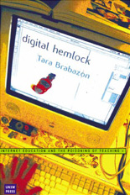
“The major justification for staff to promote internet based education is that “it increases students’ responsibility of their own learning”. However , student evaluation has demonstrated that the reverse is taking place”. BRABAZON 2002

Slide 3
“Debates on e-learning often begin by comparing apples with oranges. The 'theatre of the classroom' and the rich social tapestry of the campus are contrasted with a barren, solitary, inhuman online experience consisting of no more than downloading texts and submitting assignments.” (FELIX, 2003)

Slide 4
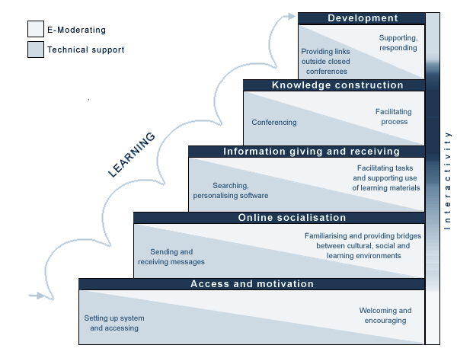

Slide 5
Blended Learning empowers language teachers
Distribute aspects of learning to free class time for what works best in class;
Support learners in developing responsibility for their own learning – language learning strategies
Support teachers in reconfiguring their role in the learning process

Slide 6
Foreign Language Anxiety
Can’t talk, won’t talk
Blushes, sweats
Avoids teacher gaze
Sits alone
Is unable to answer simple questions
Engages less and less
Stops preparing
Stops attending

Slide 7
Foreign Language Anxiety
“a distinct complex of self-perceptions, beliefs, feelings, and behaviours related to classroom language learning arising from the uniqueness of the (foreign) language learning process”
HORWITZ, 1986
LISTENING
READING
WRITING
SPEAKING

Slide 8
Foreign Language Anxiety
Often not related to motivation to learn
Often not related to trait anxiety
Often found in learners who are not unsuccessful at developing other skills
Could be caused by poor language learning strategies
Could be culturally bound
Could be caused by specific aspects of the language class

Slide 9
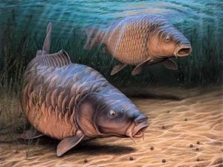
Foreign Language Anxiety
Muet comme une carpe

Slide 10
Foreign Language Anxiety
What can a language teacher do?
Embed the development of sound language learning strategies
Design playful and meaningful class activities
Not intervene – let it be
Seek to offer learner specific additional support
Face to face or online

Slide 11
Foreign Language Anxiety and computer mediated communication
Some anecdotal observations
A learner displaying strong symptoms of oral FLA in class appeared liberated on Skype
Ab initio students hindered in class reporting frequent voice exchanges on Busuu
My own experience of Busuu voice exchanges in Portuguese

Slide 12
Foreign Language Anxiety and computer mediated communication
Some thoughts
VOIP offering a different form of embodied communication
Mediation of communication offering a reassuring shield
Talking from a more intimate and controlled space

Slide 13
Foreign Language Anxiety and computer mediated communication
Insights from research
Blogging and written CMC could lower anxiety filter and support the development of oral fluency
Research on the impact of voice CMC remains limited
Technology rapidly evolving towards higher pedagogical and user affordances

Slide 14
TOWARDS AN ONLINE INTERVENTION
Existing studies tend to replicate online in asynchronous and synchronous modes what are essentially classroom pedagogies
What online pedagogy could support learners with FLA ?

Slide 15
Asynchronous mode: students as producers ex; to make videos (screencasts) image, limited text and narration / description about personally engaging and meaningful topics
Semi Synchronous mode: teacher and student meet at given times – use of voice email / teacher as e-moderator
Synchronous in virtual classroom – live presentations / discussions – semi structured
Embedding use of social networking websites for free flowing conversations
Reflective log: to monitor anxiety, discuss progress, and negotiate feedback

Slide 16
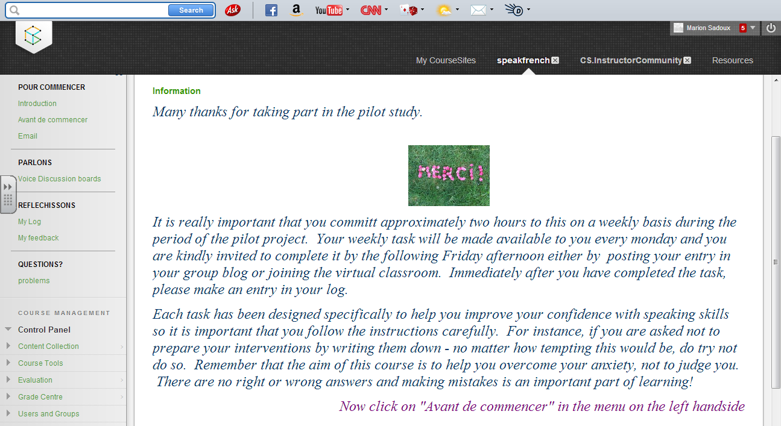
Blackboard learn as a platform
Open access
Collaborate tools and integration of video

Slide 17
Issues
Engagement: vulnerable learners
Identifying and recruiting learners
scale?

Slide 18
Interested in collaborating?
Contact sadouxm@gmail.com

Slide 19
REFERENCES
BRABAZON, T , 2002 Digital Hemlocks: the Internet and the Poisoning of Teaching, University of New South Wales, Sidney
Glucksmann, A , 1987, Descartes, c’est la France, Flammarion, Paris.
Felix, U. (2003). Teaching languages online: Deconstructing the myths. Australian Journal of Educational Technology, 19(1), 118-138.

